Slide 1
Probability and Statistics
Welcome to
MATH F113 (Probability and Statistics)
Lecture Section : 1
Lectures 1-20
By P. H. Keskar (6067D)

Slide 2
Text book : Introduction to Probability and Statistics by J. S. Milton and J. C. Arnold 4th ed.
IC : Dr. P. H. Keskar (Chamber 6067D)
Chamber hr. W 4.00 PM to 4.50 PM

Slide 3
Evaluation : Midsem (35%) (CB) 8/3 11.00 to 12.30
Tutorials (20%)
Compre. (45%) (OB and CB) 8/5 AN

Slide 4
4 unannounced class tests will be taken in tutorial classes for 20 marks each and for 15 mins duration, out of which 3 best will be consider for final evaluation.
For all the course notices, see Department of Mathematics notice board and NALANDA website.

Slide 5
Deterministic vs. statistical methods.
For many experiments in practice, we may not be able to tell precise outcome of the experiment due to some uncertainties, Statistics deals with such experiments.

Slide 6
Statistical Methods :
Descriptive Statistics: analysis of observed data.
Inferential Statistics : Using observed data to draw conclusions about general objects.
Definitions :Population : The overall group of objects about which conclusion is to be drawn. vs. sample : A portion of population obtained and used to draw conclusions.
Model building : Developing equations for the purpose of prediction using observed data.

Slide 7
Mathematical Basis
Probability theory : Mathematical basis.

Slide 8
Probabilities
Most common interpretation of probability is
(A)Frequency interpretation : To decide the probability of an event, we repeat the experiment large number of times independently.
p ≈ f / n n= no. of trials, f= no. of times the event occurred in n trials, for large n.

Slide 9

(B) Classical Probability : Under the assumption that all outcomes of the experiment are equally likely : For an event A

Slide 10
( C) Personal Probability: Based on personal judgment or feeling.
Though these are common interpretations, to put them on firm footing and also allow further generalizations, we need to develop conceptual theory of probability.

Slide 11
EX. 1.1.2 : Hemophilia is a sex-linked hereditary
blood defect of males characterized by delayed
clotting of blood which makes it difficult to
control bleeding even in case of minor injury.
When a woman is a carrier of classical
hemophilia, there is a 50% chance that a male
child will inherit the disease. If a carrier gives
birth to 2 sons, what is the probability that both boys will have disease?
By which approach?

Slide 12
Soln.
Since son is as likely to have disease as not,
assuming the independence, all 4 outcomes
YY, YN, NY, NN are equally likely, and only 1,
YY, is favourable.
By classical prob, P[A]=1/4.

Slide 13
p. 17, Ex. 2 : A sample of 72 bridges in a given state is
selected, and the bridges chosen are inspected for
structural weaknesses. If 30 of the bridges sampled
have serious problems, what is the estimated
probability that the next bridge sampled in the state
will have serious structural problems? What method
of assigning probability are you using to obtain this
estimate?

Slide 14
Birla Institute of Technology and Science, Pilani 333031
First Semester 2017-18
Notice
Course Name: Mathematics-I
Course No. MATH F111
Dear Students, Please collect your Comprehensive Examination answer sheets as per the schedule given below on 12/01/2018 (Friday) during 5.00 PM to 5.25 PM.

Slide 15
Sample spaces and events
Definition : A sample space S of an experiment is the set S such that each physical outcome of that experiment corresponds to exactly one element of S. An element of S is called a sample point.
Definition : Any subset A of the sample space S of an experiment is called an event.

Slide 16
In any sample space we have the event Φ called impossible event and an event S called certain event.
This allows us to perform various set theoretic methods to represent sample spaces and events.

Slide 17
Examples
Toss a coin successively 3 times and record the upper faces (H for head and T for tail) in sequential order.
This leads to sample space
S = {HHH, HHT, HTH, HTT, THH, THT, TTH, TTT}

Slide 18
As events we can consider subsets, e.g., empty set Φ, S, {HHH, HHT} are events.
Another event is that ‘head occurs twice’ which is same as {HHT, HTH, THH}

Slide 19
More examples
Toss a dice and record the upper face. Here S= {1,2,3,4,5,6}
Toss a dice and record Y if upper face is 5 and N otherwise. Here S ={Y, N}

Slide 20

Definition : The complement of an event A in a sample space S is an event
A' = { x ∈ S : x ∉A}.
Definition : Two events C, E in a sample space are called mutually exclusive if E∩C is an empty set.
Extending to more events: Events A₁, A₂,… are mutually exclusive if for any i≠j

Slide 21
Operations on events : Like sets, we can consider union, intersection, complements of events. They can be conveniently demonstrated by Venn diagrams.

Slide 22
counting

Slide 23
Counting
Multiplication rule : If an experiment is taking place in k stages and n_{i} denote the number of ways i^{th} stage can occur (for any occurrence in previous stages), then the experiment can occur in n₁ n₂ …n_{k} ways.

Slide 24
Y_{1,1}
Tree diagram :
x₁
Y_{1,2}
Y_{1,n2}
x₂
Y_{n1},₁
x_{n1}
Y_{n1},₂
Y_{n1},_{n2}

Slide 25
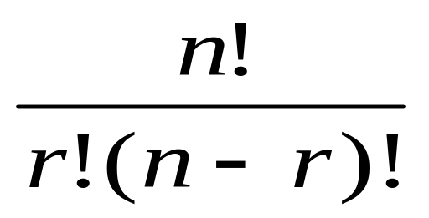

Applications of multiplication Rule :
Number of permutations of any r objects from given n distinct objects
= _{n}P_{r}= (n!)/((n-r)!).
Number of ways of choosing r objects without repetition from n given objects=

Slide 26
Ex. 1.3.20 : To get an opportunity to enter the McNeill River Brown (Grizzly) Bear Sanctuary in Alaska, one must enter a lottery. For a given year, there are 2000 individuals entered, and of these a set of 120 names will be randomly selected. Assume that you and a friend have both entered into the lottery.

Slide 27
In how many ways can a set of 120 names be randomly selected from among the 2000 entered in the drawing?
In how many ways can the drawing be done so that you and your friend are both selected?
What is the probability that you and your friend will both be chosen?

Slide 28
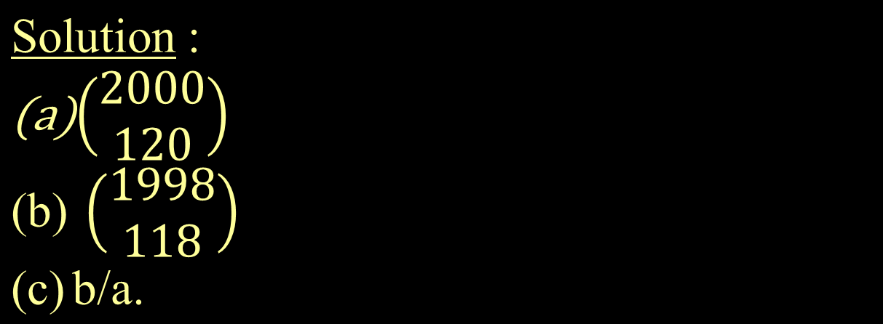

Slide 29
Example : 10 persons in a room are wearing badges marked 1 through 10. If 3 persons are asked to leave simultaneously and their badge numbers are noted, find the probability that
The smallest of these badge numbers is 5
The largest of these badge number is 5.

Slide 30
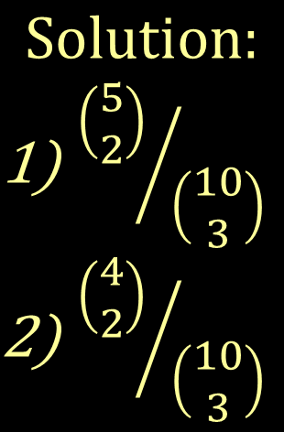
Note : In both cases, 5 is already there, so need
to choose remaining 2 to make the event.

Slide 31
EX. 1.3.21 : A firm employs 10 programmers, 8 system analysts, 4 computer engineers and 3 statisticians. A “team” is to be chosen to handle a new long-term project. The team will consist of 3 programmers, 2 system analysts, 2 computer engineers and 1 statistician.

Slide 32
In how many ways can the team be chosen?
If the customer insists that one particular engineer with whom he or she has worked before be assigned to the project, in how many ways can the team be chosen?

Slide 33
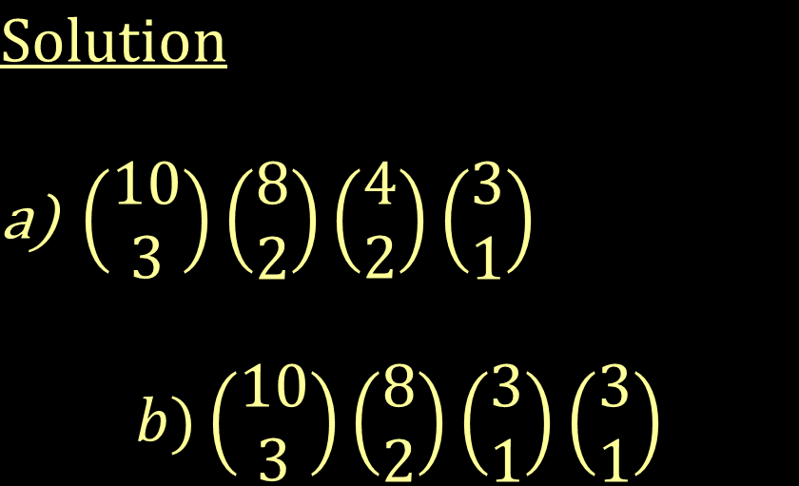

Slide 34
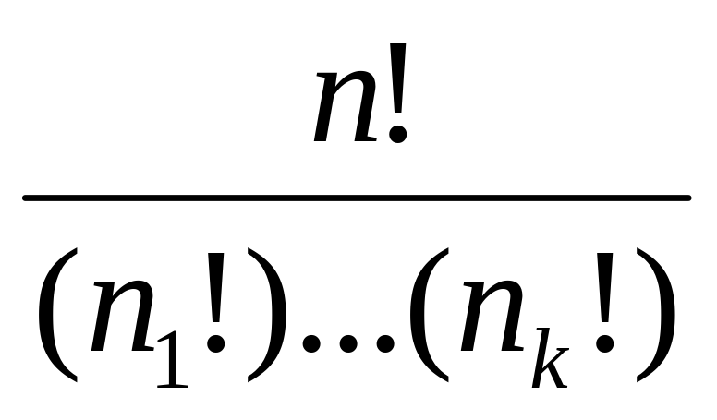
Permutations of indistinguishable objects :
If we are permuting n objects of k distinguishable types such that there are n_{i} (indistinguishable)objects of i^{th} type for i=1,2,…,k then number of
distinct arrangements of these n objects is

Slide 35
Ex. 1.review.32 : A computer system uses passwords which consist of 5 letters followed by a digit.
How many passwords are possible?
How many passwords consist of 3 A’s and 2 B’s and end in an even digit?

Slide 36
( C) If you forget a password but remember that it has characteristics described in part (B), what is the probability that you will guess the password correctly on the first attempt?

Slide 37
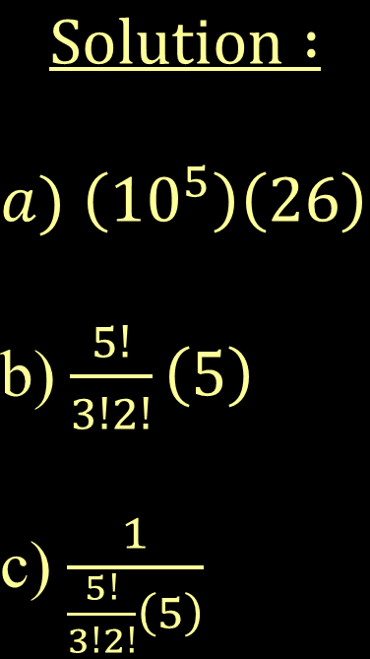
5

Slide 38
#30 A firm offers a choice of 10 free software packages to buyers of their new home computer. There are 25 packages from which to choose. (a) In how many ways can the selections be made? (b) Five of the packages are computer games. How many selections are possible if exactly three computer games are selected? (c) Is this unusual?

Slide 39
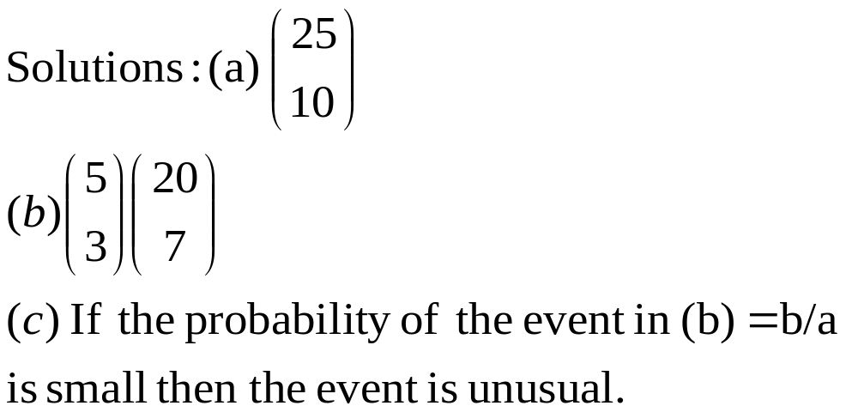

Slide 40
Axiomatic definition of probability :
Let S denote the sample space of the experiment. Then P[S]=1.
P[A] ≥ 0 for any event A.
If A₁, A₂, A₃, … are finitely many or infinite mutually exclusive events in S then P[A₁∪ A₂∪ A₃∪ …] = P[A₁]+ P[A₂]+P[A₃]+ … (additivity property).

Slide 41
Remark : Classical probability on a finite sample space satisfies axioms of probability.
Clearly if for P[A] =N(A)/N(S), 0 ≤ P[A] ≤ 1 and P[S] = 1. Also if A₁,A₂,… are mutually exclusive then
N(∪ A_{n} ) = ∑N(A_{n}) so
P[∪ A_{n} ] = ∑ P[A_{n}].

Slide 42
Personal probability need not always satisfy 3rd axiom of probability. If it does, then we say it is consistent and take it seriously.

Slide 43
If we are given that p is a probability defined axiomatically, then we are not required to prove axioms for p as we assume axioms hold for p.
If p is given by some other rule ( like classical probability) then only after proving the axioms for p can we say p is a probability in axiomatic sense.

Slide 44
Theorem : p[Φ] = 0.
(Note that Theorem states that the conclusion holds for any probability satisfying the axioms. Thus result must be derived only by using axioms and valid logic).

Slide 45
Proof : Let A =S, B = Φ. Then A∪B = S. Also A and B are mutually exclusive, since
A ∩B = Φ. Thus by 3rd axiom of probability,
P[A∪B ]= P[A] + P[B].
Hence P[S] = P[S] + P[Φ].
Subtracting P[S] from both sides, we get the result.

Slide 46
Theorem : P[A'] = 1 –P[A] for any event A.
Proof : ??

Slide 47
Theorem ( General addition rule) : For any events A, B of a sample space S,
P[A∪B] = P[A] + P[B] – P[A∩B]
Idea of Proof : We use
A∪B = (A∩B)∪( A∩B')∪(A'∩B)
And 3 events on RHS are mutually exclusive.
(Verify this)
Apply 3rd axiom to get the result.

Slide 48
It follows from the above that
P[A∪B] ≤ P[A] + P[B]. If A, B are mutually exclusive then equality holds.

Slide 49
Generalization to 3 events : P[A∪B∪C] = P[A] + P[B] + P[C] – P[A∩B]-P[A∩C] –P[B∩C] + P[A∩B∩C].
Idea of Proof : Let D= A∪B.
LHS= P[D∪C] = P[D] + P[C] – P[D ∩C]
= P[A∪B] + P[C] – P[(A∩C)∪ (B∩C)]
Now apply previous result to 1st and last term.

Slide 50

Generalization to n events : For the events A₁, …, A_{n} of the sample space,

Slide 51
Ex. 2.1.9 : Assume that in a particular military
exercise involving 2 units, Red and Blue, there
is 60% chance that Red unit will successfully
meet its objectives and a 70% chance that the
Blue unit will do so. There is 18% chance that
only Red unit will be successful. What is the
probability that both units will meet their
objectives? What is the probability that one or
the other but not both units will be successful?

Slide 52
Ex. 2.1.12 ( c) If A ⊆ B then P[A] ≤ P[B].
Note that B = (A'∩B)∪A and these 2 events are mutually exclusive.
Thus P[B] = P [A'∩B] + P[A] ≥ P[A] as the other term is nonnegative.

Slide 53
Exercise : If A, B are 2 events such that P[A]=3/4 and P[B]=5/8 then show that 3/8 ≤ P[A∩B] ≤ 5/8.
From previous ex., P[A ∩B] ≤ P[B] =5/8.
P[A']=1/4, P[B']= 3/8. Thus P[A'∪B'] ≤ 1/4 + 3/8 = 5/8. By taking complement, we get the result.

Slide 54
Conditional probability :
Many a times we have to consider events and their probabilities when certain condition on outcomes is already given.
Thus whole sample space is not of interest, only those outcomes which satisfy given condition can then be taken as sample space.

Slide 55
This has an effect of restricting sample space and considering the event when the sample space is smaller. The probability may be different as a result.
When we are considering probability of an event, the total sample space is important and must be given consideration.

Slide 56
Definition : Let A, B be events in a sample space S with P[B] > 0. The conditional probability of A given B is defined to be :
P[A|B] = P[A∩B] / P[B].

Slide 57
Illustration : In a survey of students, 20% of students were females and 10% of all students were female science students.
This can be interpreted in terms of probability thus :
Sample space S = set of all students.
Event F = set of all female students.
Event SC = set of all science students.
Given : P[F]=0.2, P[F∩SC]=0.1.

Slide 58
We can ask : What percentage of female students are Science students?
This asks the conditional probability P[SC|F] .
Alternatively same can be phrased as :
What is the probability that a randomly chosen student is science student given the student is female?
What is the probability that a (randomly chosen) female student is a science student?

Slide 59
From the definition of conditional probability follows the following multiplication rule :
If P[B] > 0 then
P[A∩B] = P[A|B]P[B].
If P[A] >0, then we can also revert the roles of A and B.
If we are given any 2 of the 3 probabilities, we can determine the 3rd.

Slide 60
Multiplication rule for n events :Let A₁, …,
A_{n} be events such that P[A₁∩…∩A_{n-1}] ≠ 0.
Then
P[A₁∩…∩A_{n}]=
P[A₁]P[A₂| A₁]… P[A_{n} |A₁∩…∩A_{n-1}] .

Slide 61
Cause-effect relationship : The conditional probability P[A|B] can be interpreted as the probability that event B is a cause of event A (I.e. A is caused by B or equivalently A is the effect of B).
Note that if B ⊆A then the percentage of cases in B which come from A is 100, thus A is certainly an effect of B (I.e. the probability that B is the cause of A is 1).

Slide 62
Thus if 30% of population lives in slums, and 1% of population lives in slum as well as has a TV set at home, then the probability that a person living in slums has a TV set is 1/30.
This can be interpreted as : probability that having a TV is caused by a person to live in slum is 1/30.

Slide 63
Exercise 23 : The use of plant appearance in
Prospecting for ore deposits is called geobotanic
prospecting. One indicator of copper is a small
Mint with a mauve-colored flower. Suppose that, for a given region, there is a 30% chance that the soil has a high copper content and a 23% chance that the mint will be present there. If the copper content is high, there is 70% chance that the mint will be present.

Slide 64
Find the probability that the copper content
will be high and mint will be present.
(B) Find the probability that copper content will be high given that mint is present.
Can you find the probability that copper content
is not high given mint is present? Probability
that copper content is high given mint is not
present?

Slide 65
Independence
Definition: Events A₁ and A₂ are said to be independent if P[A₁ ∩ A₂]=P[A₁]P[A₂].
Moreover for a finite collection C={A_{i} : i=1,…,n} of events, the events are independent if and only if for any subcollection A₍₁₎ , …, A_{(m)} of elements of C,
P[A₍₁₎ ∩… A_{(m)}]=P[A₍₁₎]…P[A_{(m)}].

Slide 66
Notes : (1)There is difference between two events being mutually exclusive and independent.(Check definitions)
Give an example of mutually exclusive events which are (I) independent, (II) dependent. Also give example of independent events which are (I) mutually exclusive (II) not mutually exclusive.

Slide 67
(2) For n events, they are mutually exclusive if
each pair of distinct events are so.
What about independence?
Independence ⇒ all pairs are independent.
(obvious)
Converse? Not true.

Slide 68
Ex. In two independent tosses of a fair coin, let
A : 1st toss is a head
B : 2nd toss is a tail
C : ocurrences of 1st and 2nd toss are same.
These events are pairwise independent but not
independent.

Slide 69
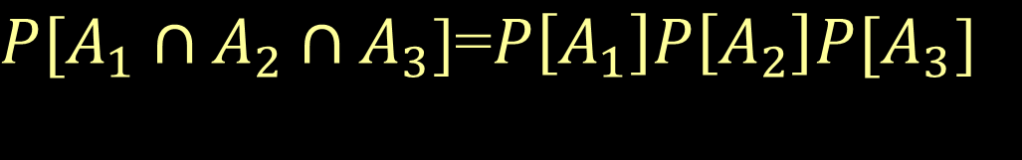
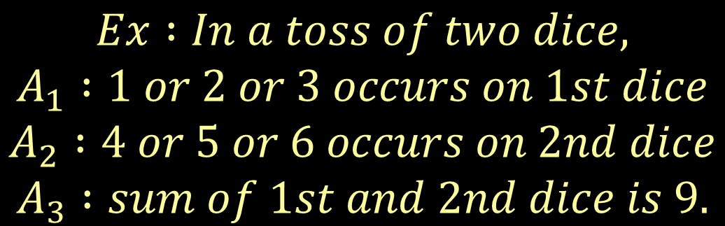
There are also events A₁, A₂, A₃ such that
But events are not independent.

Slide 70
Example (2.3.1) : Consider the experiment of drawing a card from a well shuffled pack of 52 cards. Let
A₁ : a spade is drawn, A₂ : an honor (10, J, Q, K,A) is drawn.
Are they independent? Why?

Slide 71
Note : If P[A₂]≠ 0 then A₁ and A₂ are
independent if and only if
P[A₁|A₂]=P[A₁].
Thus, in the previous example, if we have an
extra information that a card is spade, this does
not influence the probability that a drawn card is
an honor.

Slide 72
In practice, independence occurs in the following manner :
If an experiment consists of two unrelated parts, their outcomes can be thought as independent.
Examples: (1) Draw a card randomly from a pack of cards. Put it back, shuffle well and then pick the top card. Record both cards in sequence. The events : (a) first card is an ace and (b) second card is an ace are independent.

Slide 73
(2) Draw a card randomly from a pack of cards. Then without putting it back, shuffle it well and then pick the top card. Record the drawn cards in sequence. Then events (a) first card is an ace and (b) second card is an ace are not independent.

Slide 74
Exercise : If A and B are independent and 0 < P(B) < 1 then A' and B are also independent.

Slide 75
Bayes’ theorem : If A₁, …, A_{n} is a collection of mutually exclusive events whose union is the sample space S such that P[A_{i}] ≠ 0 for any I and B is any event with P[B] ≠ 0 then for any r,

Slide 76
Bayes’ theorem can be interpreted as reverting the roles of cause and effect. If we know the probabilities of certain events causing an event (and also probabilities of causes) then we can find probability that any effect is the cause of the original cause.
The assumptions on the effects A₁,…,A_{n} are essential for the validity of Bayes’ theorem. In stead of assuming their union is S, it is enough to check sum of their probabilities is 1. That they are mutually exclusive is still necessary.

Slide 77
Fact : If A₁, …, A_{n} are mutually exclusive events and one of them must occur (I.e., their union is the sample space S, also called exhaustive) then for any event B,

Slide 78
Tree diagram version of the fact:
P[B|A₁]
A₁
B
P[A₁]
P[A₂]
A₂
P[B|A₂]
B
P[A_{n}]
P[B|A_{n}]
B
A_{n}

Slide 79
Exercise review.40 : A power network involves 3
substations A, B, C. Overload at any of these
substations might result in a blackout of the
entire network. Past history has shown that if a
substation A alone experiences overload, there is
1% chance of a network blackout. For stations B
and C these percentages are 2% and 5%
respectively. Overload at 2 or more substations
result in a blackout 5% of the time. During a heat
wave, there is a 60% chance that substation A
alone will experience overload.

Slide 80
For stations B and C, these percentages are 20 and 15% respectively. There is a 5% chance of an overload at two or more stations simultaneously. During a particular heat wave, a blackout due to an overload occurred. Find the probability that the overload occurred at substation A alone.

